Slide 1
First output model for Typhoon (compared with Boulder model)
15.October 2022.

Slide 2
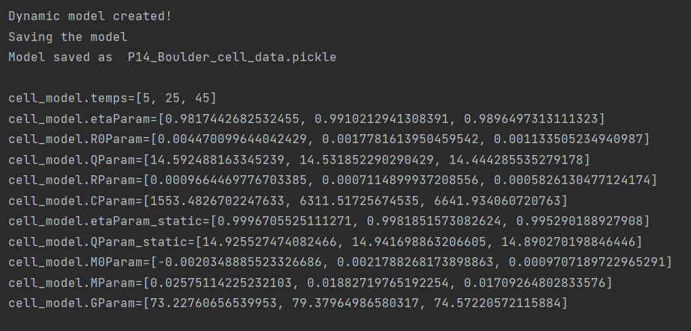
Boulder results in my script
THEIR RESULTS IN OCTAVE
R0 = [4.6198e-3, 1.7810e-3, 1.1351e-3]
Eta = [0.98174, 0.99102, 0.98965]
Qparam = [14.592, 14.532, 14.444]
Rparam = [0.0008368, 0.64769e-3, 0.000535]
Rcparam = [2.3844, 5.1555, 4.2939]
Cparam = 7.9598e3
M0Param = [0.0031315, 0.0023535, 0.0011502]
Mparam = [0.039929, 0.020018, 0.020545]
Gparam = [67.207, 92.645, 67.840]

Slide 3
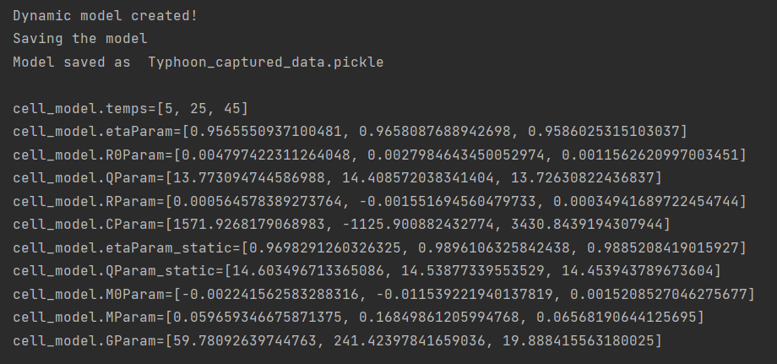
Some problems with Eigenvalues which translate into negative R param and C param
THEIR RESULTS IN OCTAVE
R0 = [4.6198e-3, 1.7810e-3, 1.1351e-3]
Eta = [0.98174, 0.99102, 0.98965]
Qparam = [14.592, 14.532, 14.444]
Rparam = [0.0008368, 0.64769e-3, 0.000535]
Rcparam = [2.3844, 5.1555, 4.2939]
Cparam = 7.9598e3
M0Param = [0.0031315, 0.0023535, 0.0011502]
Mparam = [0.039929, 0.020018, 0.020545]
Gparam = [67.207, 92.645, 67.840]

Slide 4
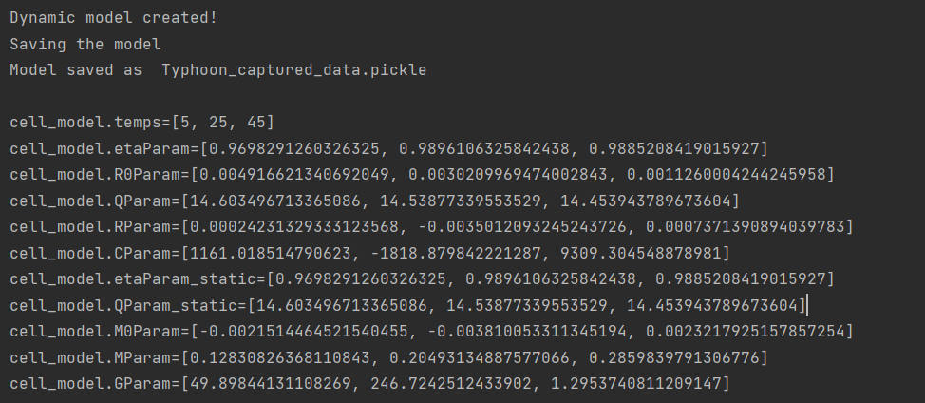
Now, using same eta and Q from the static test
THEIR RESULTS IN OCTAVE
R0 = [4.6198e-3, 1.7810e-3, 1.1351e-3]
Eta = [0.98174, 0.99102, 0.98965]
Qparam = [14.592, 14.532, 14.444]
Rparam = [0.0008368, 0.64769e-3, 0.000535]
Rcparam = [2.3844, 5.1555, 4.2939]
Cparam = 7.9598e3
M0Param = [0.0031315, 0.0023535, 0.0011502]
Mparam = [0.039929, 0.020018, 0.020545]
Gparam = [67.207, 92.645, 67.840]

Slide 5
OCV default vs OCV parsed (should be the same)

Slide 6
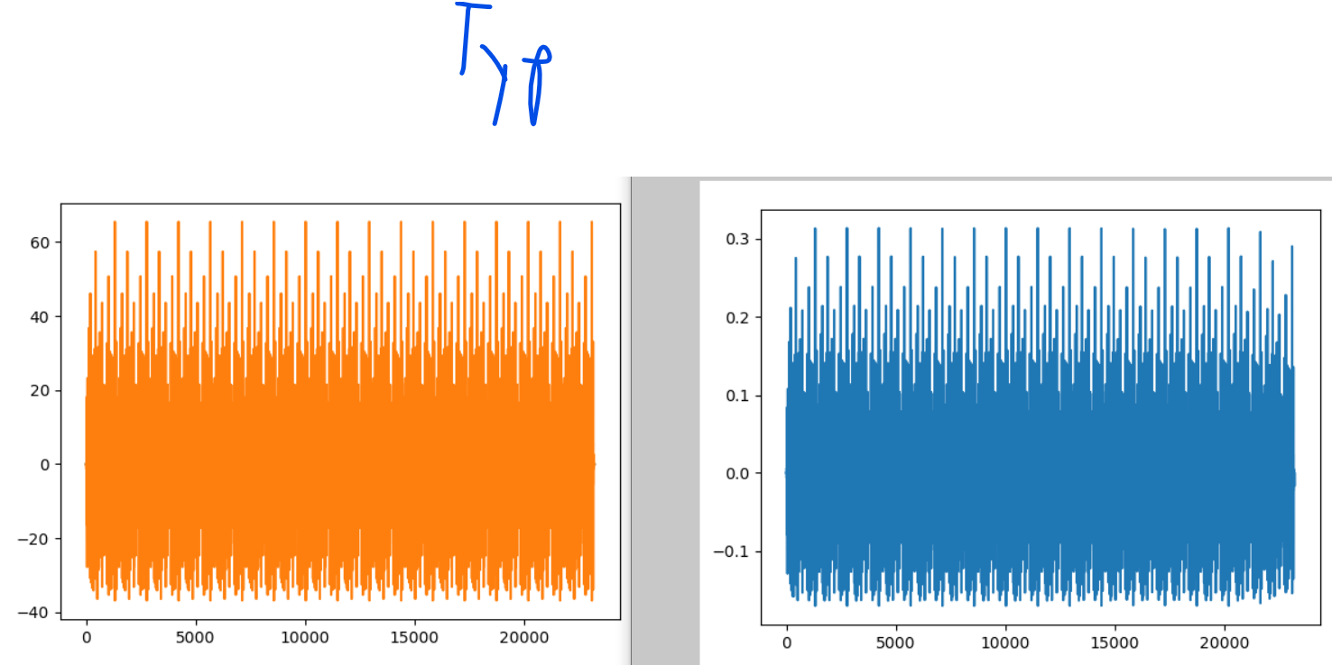
Problems probably come from v_error and corrected current calculation

Slide 7
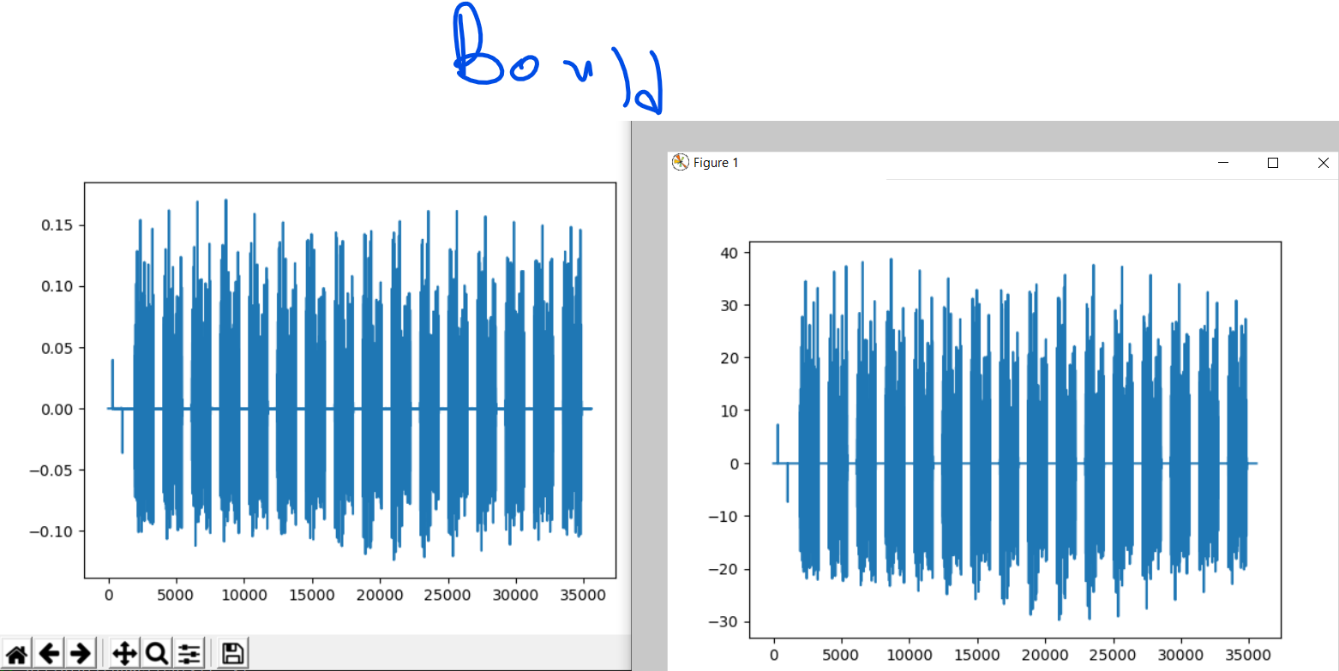

Slide 8
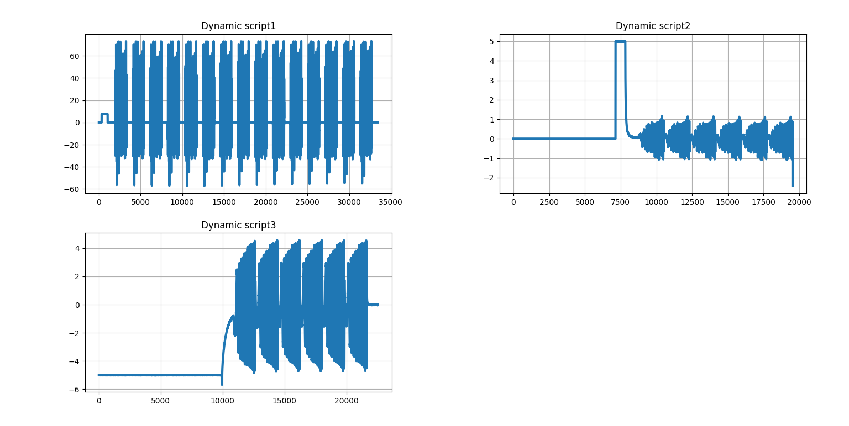
dynamic_scripts_current

Slide 9
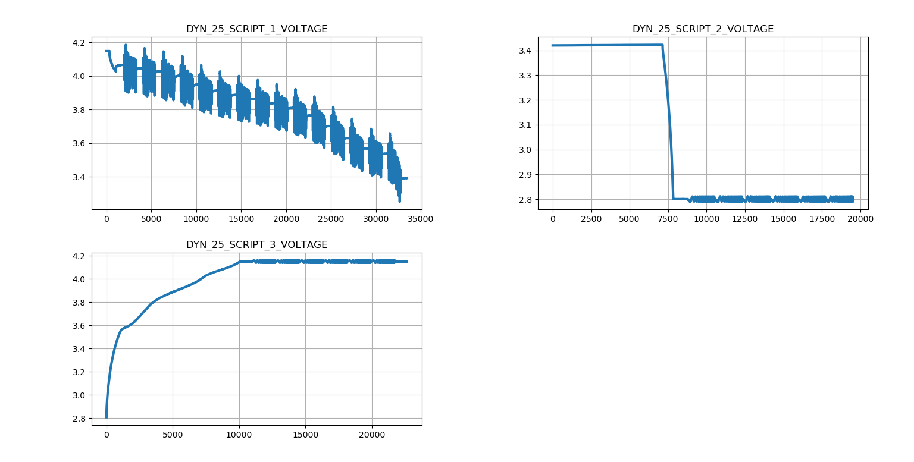
dynamic_scripts_voltage

Slide 10
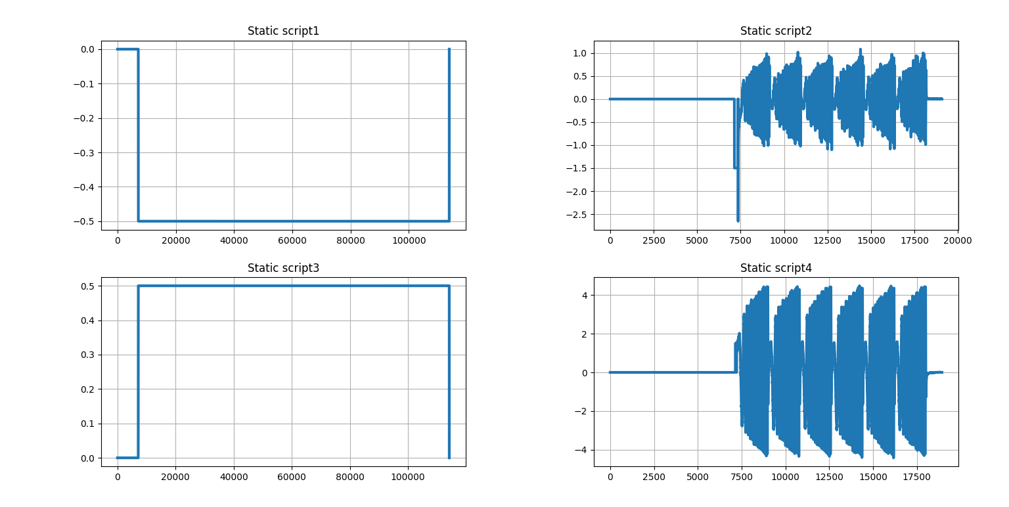
static_scripts_current_original

Slide 11
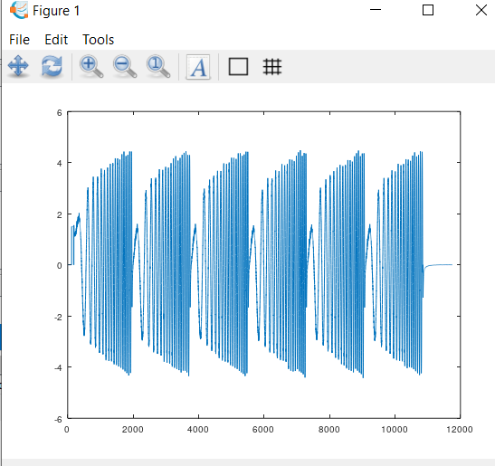
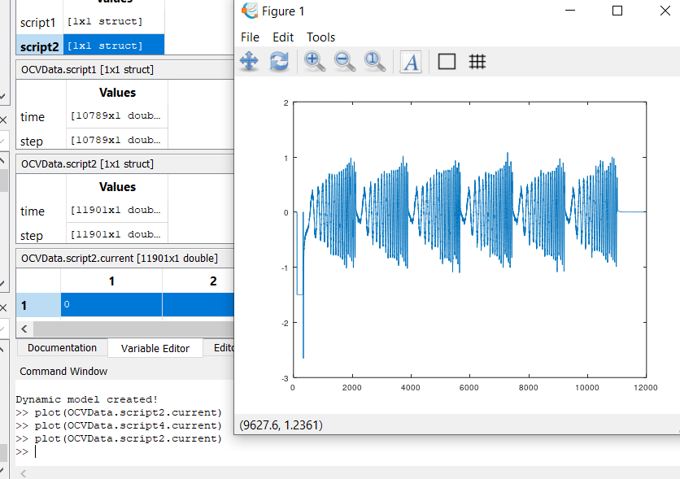
static_scripts_current_original

Slide 12
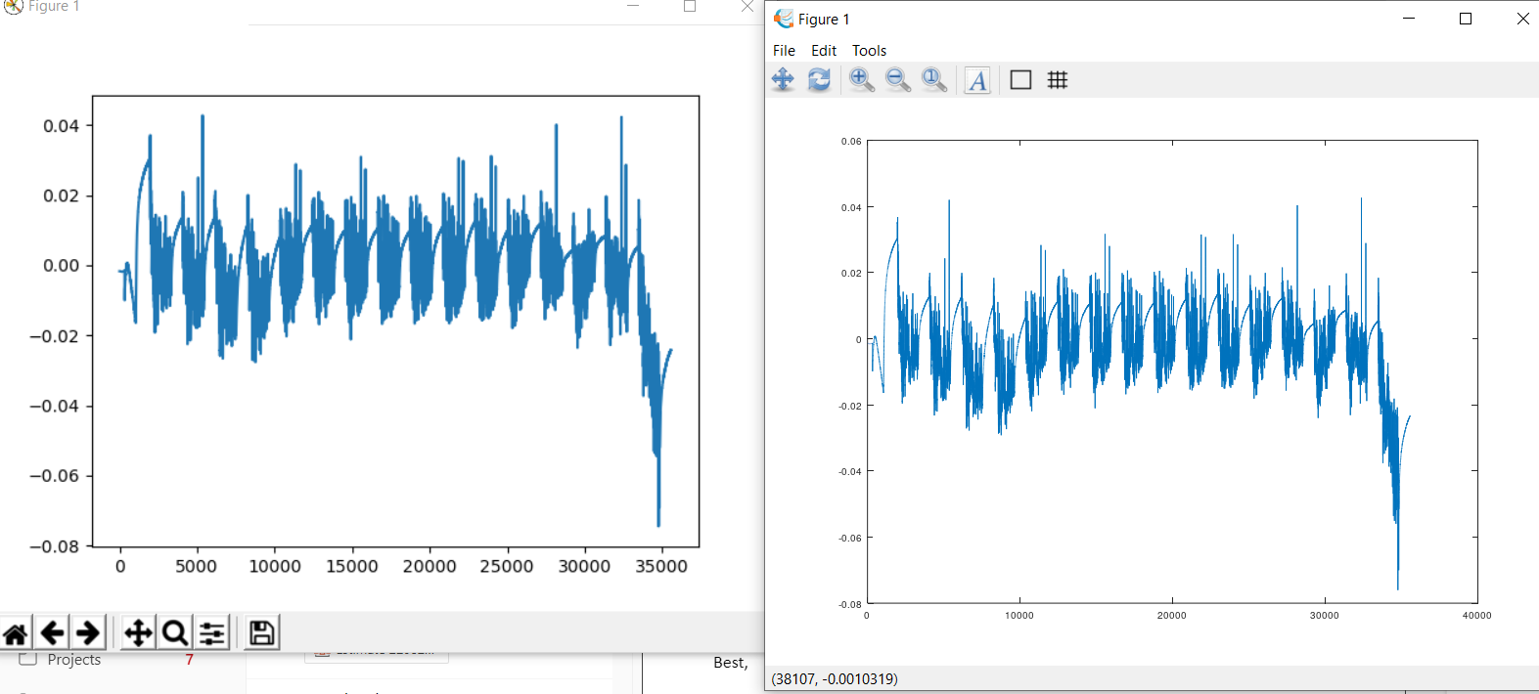
Comparison between Python parsing of Boulder data and Octave parsing of Boulder data. Variable = verr

Slide 13
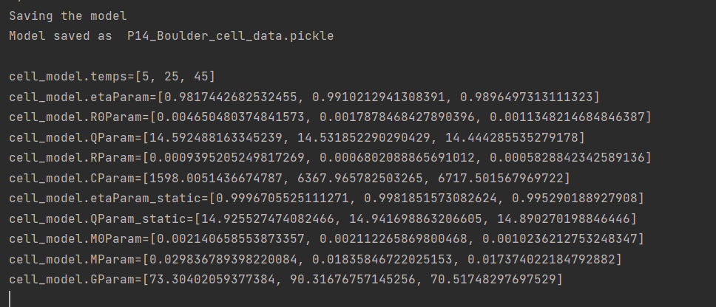
Boulder data looks better with this change: if abs(script_1_current[k]) < current_sign_threshold: where the threshold is now 1e-8 instead of Q/100. Specifically, M0 has nonnegative values

Slide 14
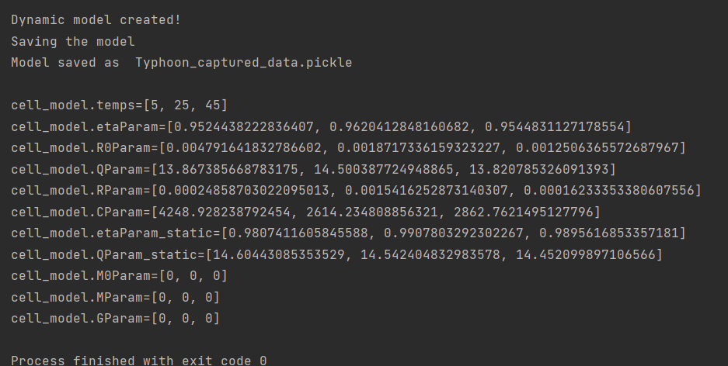
No hysteresis typhoon data. I used the newly updated hysteresis behavior.
THEIR RESULTS IN OCTAVE
R0 = [4.6198e-3, 1.7810e-3, 1.1351e-3]
Eta = [0.98174, 0.99102, 0.98965]
Qparam = [14.592, 14.532, 14.444]
Rparam = [0.0008368, 0.64769e-3, 0.000535]
Rcparam = [2.3844, 5.1555, 4.2939]
Cparam = 7.9598e3
M0Param = [0.0031315, 0.0023535, 0.0011502]
Mparam = [0.039929, 0.020018, 0.020545]
Gparam = [67.207, 92.645, 67.840]

Slide 15
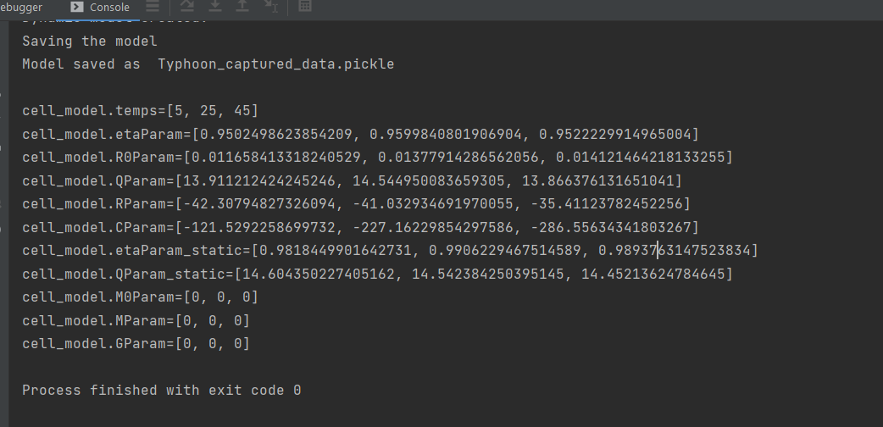
No hysteresis, no RC, FULL VHIL typhoon data.
THEIR RESULTS IN OCTAVE
R0 = [4.6198e-3, 1.7810e-3, 1.1351e-3]
Eta = [0.98174, 0.99102, 0.98965]
Qparam = [14.592, 14.532, 14.444]
Rparam = [0.0008368, 0.64769e-3, 0.000535]
Rcparam = [2.3844, 5.1555, 4.2939]
Cparam = 7.9598e3
M0Param = [0.0031315, 0.0023535, 0.0011502]
Mparam = [0.039929, 0.020018, 0.020545]
Gparam = [67.207, 92.645, 67.840]

Slide 16
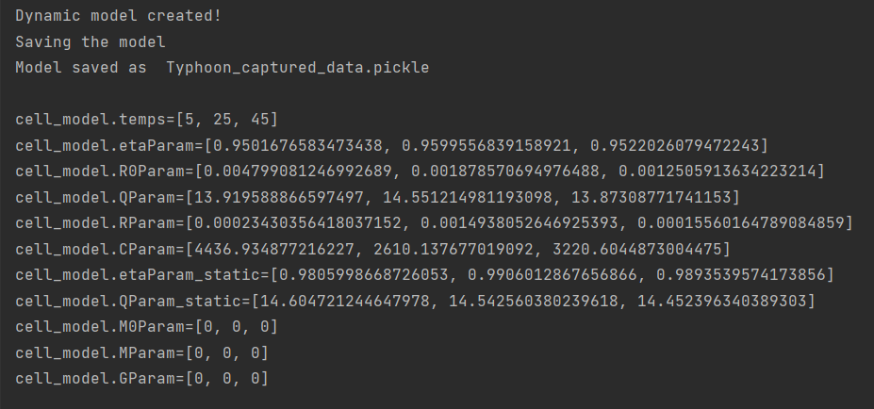
No hysteresis, no RC, VHIL typhoon data.
THEIR RESULTS IN OCTAVE
R0 = [4.6198e-3, 1.7810e-3, 1.1351e-3]
Eta = [0.98174, 0.99102, 0.98965]
Qparam = [14.592, 14.532, 14.444]
Rparam = [0.0008368, 0.64769e-3, 0.000535]
Rcparam = [2.3844, 5.1555, 4.2939]
Cparam = 7.9598e3
M0Param = [0.0031315, 0.0023535, 0.0011502]
Mparam = [0.039929, 0.020018, 0.020545]
Gparam = [67.207, 92.645, 67.840]

Slide 17
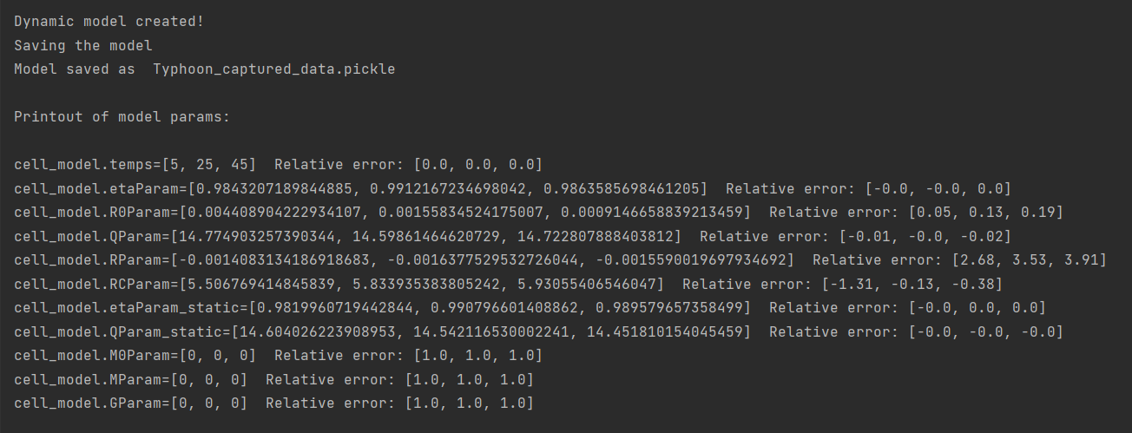
No hysteresis, 1 RC, VHIL typhoon data.

Slide 18
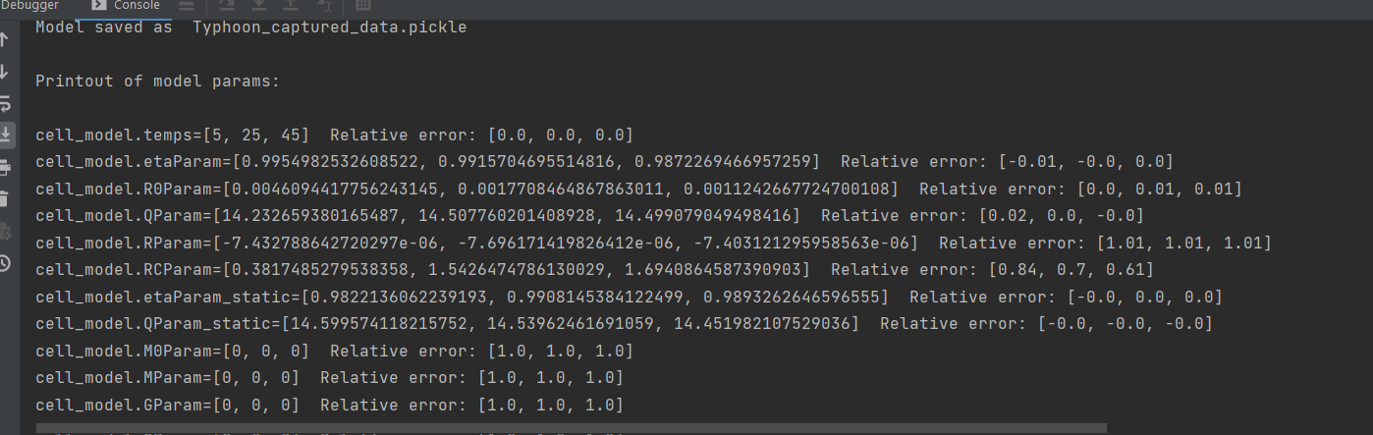
11.11.2022. Finally R0 is better

Slide 19
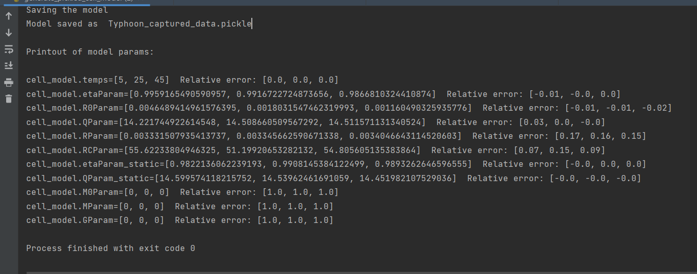
11.11.2022. RC circuit testing (RC = 60, R = 4 miliohm) using SISOSubid

Slide 20
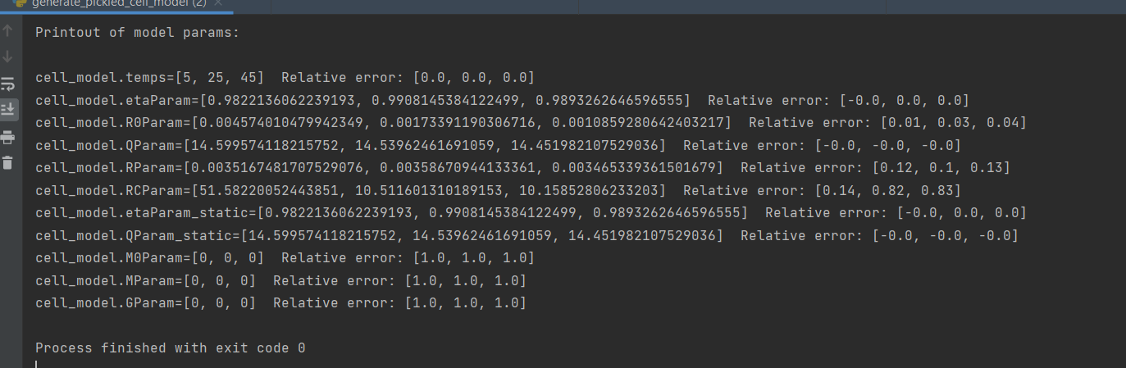
20.11.2022. RC circuit testing (RC = 60, R = 4 miliohm), this time using differential_evolution

Slide 21
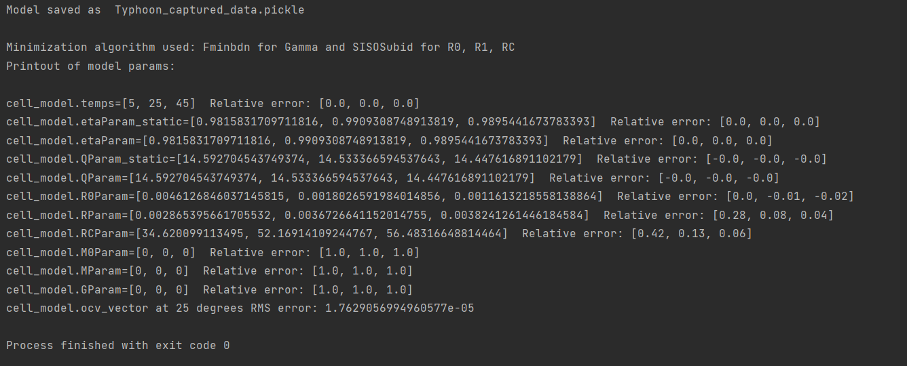
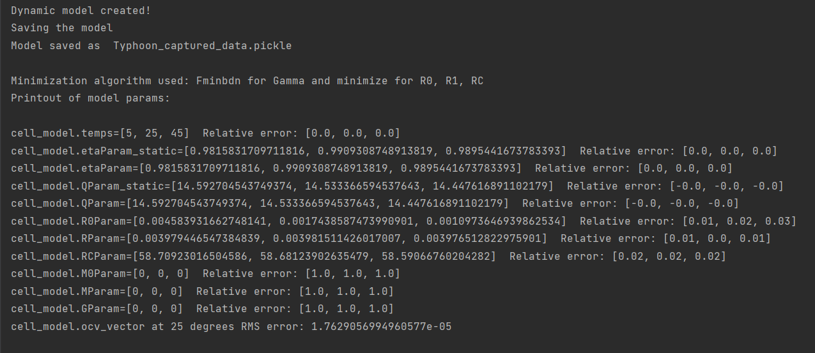
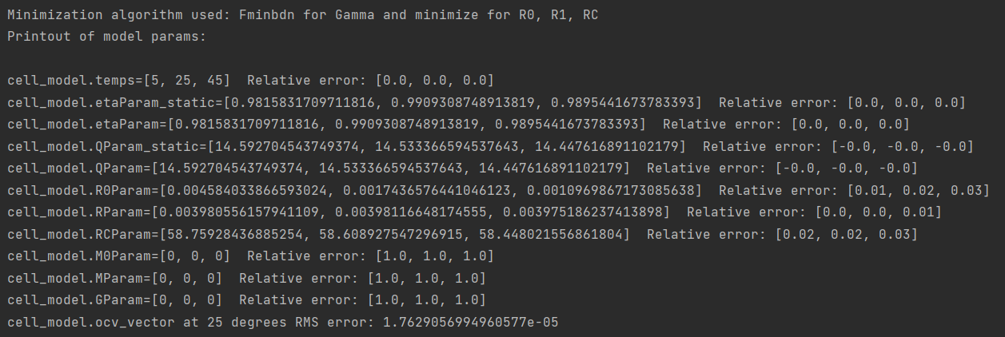
Same data, SISO vs Powell minimize and differential_evolution give great and similar results

